Slide 1
Advanced Ethical Hacking
SQL Injection and Wireless Networks

Slide 2
What is SQL?
SQL stands for Structured Query Language
SQL lets you access and manipulate databases
What Can SQL do?
SQL can execute queries against a database
SQL can retrieve data from a database
SQL can insert records in a database
SQL can update records in a database
SQL can delete records from a database
SQL can create new databases
SQL can create new tables in a database
SQL can create stored procedures in a database
SQL can create views in a database
SQL can set permissions on tables, procedures, and views

Slide 3
SQL Injection
SQL injection is a code injection technique that might destroy your database.
SQL injection is one of the most common web hacking techniques.
SQL injection is the placement of malicious code in SQL statements, via web page input.

Slide 4
SQL in Web Pages
SQL injection usually occurs when you ask a user for input, like their username/userid, and instead of a name/id, the user gives you an SQL statement that you will unknowingly run on your database.
Eg: txtUserId = getRequestString("UserId");
txtSQL = "SELECT * FROM Users WHERE UserId = " + txtUserId;

Slide 5
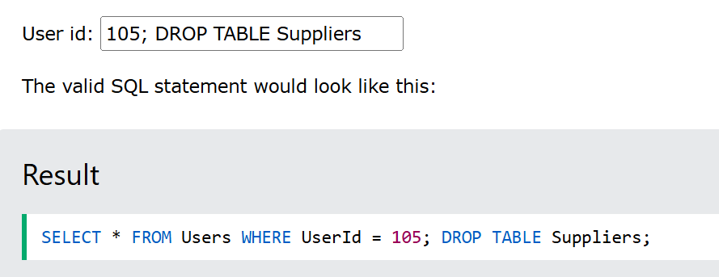

Slide 6
Types of SQL Injections
In-band SQLi
In-band SQLi is a common type of attack and is known for its simplicity and efficiency. This method has two variations: error-based and union-based.
1. Error-based SQLi
Attackers inject SQL queries hoping that the database will return error messages, which can give attackers information about the database and its structure.
2. UNION-based SQLi
In this scenario, attackers use the UNION SQL operator for the database to return a single Hypertext Transfer Protocol (HTTP) response. Attackers can then evaluate the response for clues about the contents of a database.

Slide 7
Inferential (Blind) SQLi
In inferential or blind SQLi attacks, fraudsters query the database and observe the server's behavior to gather information about the database's structure. These types of attacks are slower, but they can be equally harmful as other types of SQLi. There are two types: boolean and time-based.
1. Boolean
The attacker queries the database, and by studying whether the HTTP response was modified or stayed the same, they can determine whether the result was true or false.
2. Time-based
As its name implies, the attacker studies the response time, in seconds, of a query result. As with the boolean type, the attacker looks closely at the HTTP response to determine whether the query was true or false.

Slide 8
Out-of-band SQLi
This is a special SQLi case that can only work if certain features of the database server used by the application are turned on. Out-of-band SQLi is considered an alternative to in-band and inferential techniques. Out-of-band SQLi does not rely on the attacker querying the database to examine error messages or HTTP responses. Instead, it expects the server to generate Domain Name System (DNS) or HTTP requests so that the attacker can obtain data such as usernames and passwords.

Slide 9
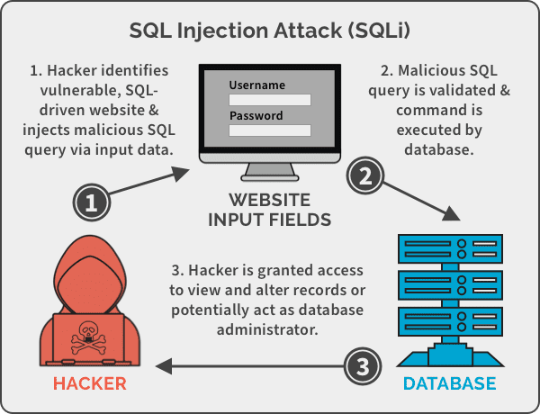
SQL injection methodology

Slide 10
The single quote character ' and look for errors or other anomalies.
Some SQL-specific syntax that evaluates to the base (original) value of the entry point, and to a different value, and look for systematic differences in the application responses.
Boolean conditions such as OR 1=1 and OR 1=2, and look for differences in the application's responses.

Slide 11
SQL injection tools
sqlmap
Burp Suite

Slide 12
Evasion techniques
White Space Manipulation :
Whitespace characters, including spaces, tabs, and newlines, are often present in string data within SQL databases. While generally ignored by the SQL parser in terms of query syntax, whitespace within string values can significantly impact data integrity, consistency, and query results, especially during comparisons, joins, and reporting.

Slide 13
comment exploitation
An attacker uses a database-specific comment marker to modify or disable parts of an original SQL query. This allows the attacker's malicious code to execute while preventing the legitimate parts of the query from running, thereby bypassing security measures.

Slide 14
Encoding Techniques
URL Encoding:
URL encoding, also known as percent-encoding, is a standard method for converting characters into a format that can be safely transmitted over the internet. Attackers use this to hide special characters.
How it works: Special characters are replaced with a percent sign (%) followed by their hexadecimal value. For example, a single quote (') becomes %27, and a space becomes %20.
Example: An attacker wants to inject ' OR 1=1 --. A simple WAF might block this. The attacker can URL encode the payload to %27%20OR%201=1%20--. The WAF might not recognize this encoded string, but the web server will decode it before sending it to the database, allowing the attack to succeed.

Slide 15
Hexadecimal Encoding
Hexadecimal encoding converts characters into their hexadecimal representations. This is another way to make a malicious string appear harmless to security filters.
How it works: Each character is represented by its two-digit hexadecimal value prefixed with 0x.
Example: The keyword UNION could be encoded as 0x554E494F4E. An attacker could inject a query like SELECT * FROM users WHERE id = 1 UNION SELECT 1, 2, 3. To evade a WAF, they might encode the UNION part. The final payload might look something like SELECT * FROM users WHERE id = 1 UNION SELECT 1, 2, 3. This technique is especially useful in blind SQLi attacks where the attacker is trying to infer data one character at a time.

Slide 16
Unicode Encoding
Unicode encoding allows for the representation of characters from almost all writing systems. Attackers can use this to bypass filters that are not configured to handle various character sets.
How it works: Characters are represented using a \u followed by a four-digit hexadecimal value.
Example: A single quote (') can be represented as \u0027. If a WAF only filters for the ASCII representation of the single quote, it might miss the Unicode version, allowing the injection to pass through.

Slide 17
Countermeasures
Validate all input before it reaches your database
Use parameterized queries or prepared statements
Enforce principle of least privilege on database accounts
Keep your software stack patched and up to date
Use a Web Application Firewall (WAF)
Encrypt sensitive data to limit breach impact

Slide 18
Wireless Networks
A wireless network refers to a computer network that makes use of Radio Frequency (RF) connections between nodes in the network. Wireless networks are a popular solution for homes, businesses, and telecommunications networks.

Slide 19
Types Of Wireless Network Connections
LAN
A local-area network is a computer network that exists at a single site, such as an office building. It can be used to connect a variety of components, such as computers, printers, and data storage devices. LANs consist of components like switches, access points, routers, firewalls, and Ethernet cables to tie it all together. Wi-Fi is the most commonly known wireless LAN.
PAN
A personal-area network consists of a network centralized around the devices of a single person in a single location. A PAN could have computers, phones, video game consoles, or other peripheral devices. They are common inside homes and small office buildings. Bluetooth is the most commonly known wireless PAN.

Slide 20
MAN
A metropolitan-area network is a computer network that spans across a city, small geographical area, or business or college campus. One feature that differentiates a MAN from a LAN is its size. A LAN usually consists of a solitary building or area. A MAN can cover several square miles, depending on the needs of the organization.
Large companies, for example, may use a MAN if they have a spacious campus and need to manage key components, such as HVAC and electrical systems.
WAN
A wide-area network covers a very large area, like an entire city, state, or country. In fact, the internet is a WAN. Like the internet, a WAN can contain smaller networks, including LANs or MANs. Cellular services are the most commonly known wireless WANs.

Slide 21
Wireless encryption
Wireless encryption secures your wireless network with an authentication protocol. It requires a password or network key when a user or device tries to connect. If your wireless network isn't secure, unauthorized users could access your network and obtain personal information or use your internet connection for malicious or illegal activity. Your network speed or performance may decrease if people use your network without your knowledge.

Slide 22
Wired Equivalent Privacy (WEP)
WEP uses the RC4 (Rivest Cipher 4) stream cipher for authentication and encryption. The standard originally specified a 40-bit, preshared encryption key.
An administrator must manually enter and update the key, which combines with a 24-bit initialization vector (IV) in an effort to strengthen encryption.
The small size of the IV increases the likelihood that users will recycle keys, however, making them easier to crack.
This characteristic, along with several other security flaws and vulnerabilities -- including problematic authentication mechanisms -- makes WEP a risky choice for wireless security.

Slide 23
Types of wireless encryptions
Wired Encryption Privacy or Wired Encryption Protocol or Wired Equivalent Privacy (WEP)
Encryption Type
64-bit: This configuration requires a ten character password when you use a hexadecimal (zero to nine and A-F) digits or eight characters when you use ASCII characters.
128-bit: This configuration requires a 26 character password when you use hexadecimal digits or 14 characters when you use ASCII characters.

Slide 24
Advantages
Easy to configure.
Widely supported security system.
Secures your wireless network better than no encryption at all.
Disadvantages
Not fully secure.
Other encryption protocols are more secure.

Slide 25
Wi-Fi Protected Access (WPA)
WPA has discrete modes for enterprise users and for personal use.
The enterprise mode, WPA-Extensible Authentication Protocol (WPA-EAP), uses more stringent 802.1x authentication and requires the use of an authentication server.
The personal mode, WPA-Pre-Shared Key (WPA-PSK), uses preshared keys for simpler implementation and management among consumers and small offices.

Slide 26
Although WPA is also based on RC4, it introduced several enhancements to encryption -- namely, the use of the Temporal Key Integrity Protocol (TKIP). TKIP contained a set of the following functions to improve WLAN security:
use of 256-bit keys;
per-packet key mixing, which generates a unique key for each packet;
automatic broadcast of updated keys;
message integrity check;
larger IV size using 48 bits; and
mechanisms to reduce IV reuse.

Slide 27
WPA2
WPA2 replaces RC4 and TKIP with two stronger encryption and authentication mechanisms:
Advanced Encryption Standard (AES), an encryption mechanism; and
Counter Mode with Cipher Block Chaining Message Authentication Code Protocol (CCMP), an authentication mechanism.
Also meant to be backward-compatible, WPA2 supports TKIP as a fallback if a device cannot support CCMP.

Slide 28
Developed by the U.S. government to protect classified data, AES comprises three symmetric block ciphers. Each cipher encrypts and decrypts data in blocks of 128 bits using 128-, 192- and 256-bit keys. Although the use of AES requires more computing power from APs and clients, ongoing improvements in computer and network hardware have mitigated performance concerns.
CCMP protects data confidentiality by allowing only authorized network users to receive data. It uses cipher block chaining message authentication code to ensure message integrity.
WPA2 also introduced more seamless roaming, enabling clients to move from one AP to another on the same Wi-Fi network without having to reauthenticate, using Pairwise Master Key (PMK) caching or pre-authentication.

Slide 29
Wi-Fi Protected Access (WPA and WPA2)
Encryption Type
TKIP: Temporal Key Integrity Protocol
PSK: Pre-shared Key or Personal mode. 256-bit encryption that requires a 64 hexadecimal digit password or a 8 - 63 ASCII character passphrase.
EAP: Extensible Authentication Protocol
Advantages
Easy to configure.
Strong encryption.
Easy to manage.
Disadvantages
Not supported by all devices.

Slide 30
Wireless Protected Setup (WPS)
Wireless Protected Setup (WPS) is a network security standard designed to simplify the process of connecting devices to a secure wireless network.
Developed by the Wi-Fi Alliance, WPS allows users to connect devices with a push button or PIN—without needing to manually enter the Wi-Fi password.
WPS makes it easier to configure wireless networks with WPA or WPA2 encryption by streamlining the authentication process.

Slide 31
How Does Wireless Protected Setup Work?
Push Button Method
You press the WPS button on your router, then press a similar button on your device (or select WPS from software settings). Within seconds, the device joins the network securely.
PIN Entry Method
Every WPS-enabled router has an 8-digit PIN printed on it. Enter this PIN into your device to establish a secure connection.
Example: On a printer, you might navigate to wireless settings > WPS PIN, then enter the router’s PIN to connect.

Slide 32
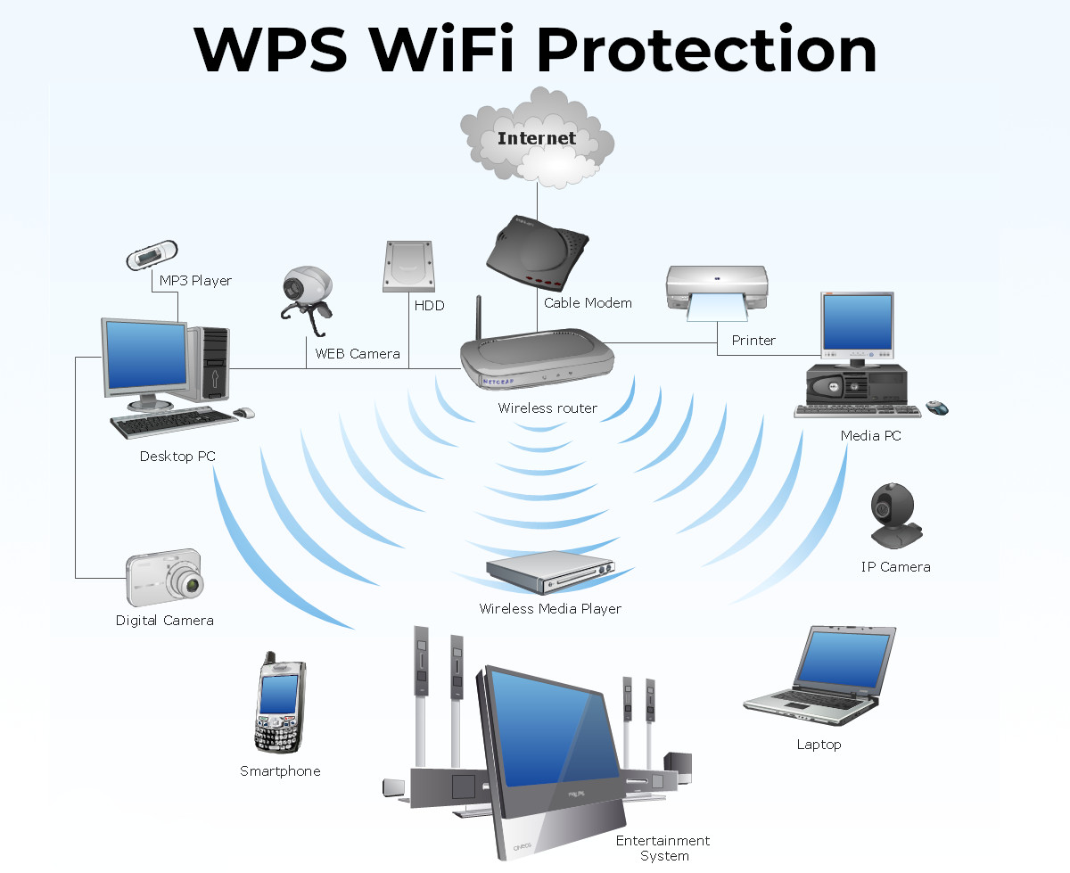

Slide 33
Wi-Fi Protected Setup (WPS)
Advantages
Automatically configures a wireless network with a network name (SSID) and a strong WPA security key for authentication and data encryption.
Supports various Wi-Fi certified 802.11 products, ranging from access points, wireless adapters, Wi-Fi phones, and other electronic devices.
You don't need to know the SSID or security key or passphrase when you connect into WPS enabled devices.
The security key or passphrase is randomly generated so no one can guess it.
No predictable passphrases or long sequences of hexadecimal characters to enter.
Disadvantages
Ad-Hoc mode where wireless devices communicate directly to each other without an access point is not supported.
All of the Wi-Fi devices on the network must be WPS certified or compatible, otherwise you won't be able to take advantage of the ease in securing the network.
Difficult to add a non-WPS client device to the network because of the long sequences of hexadecimal characters generated by the WPS technology.
WPS technology is fairly new, so not every manufacturer supports it.

Slide 34
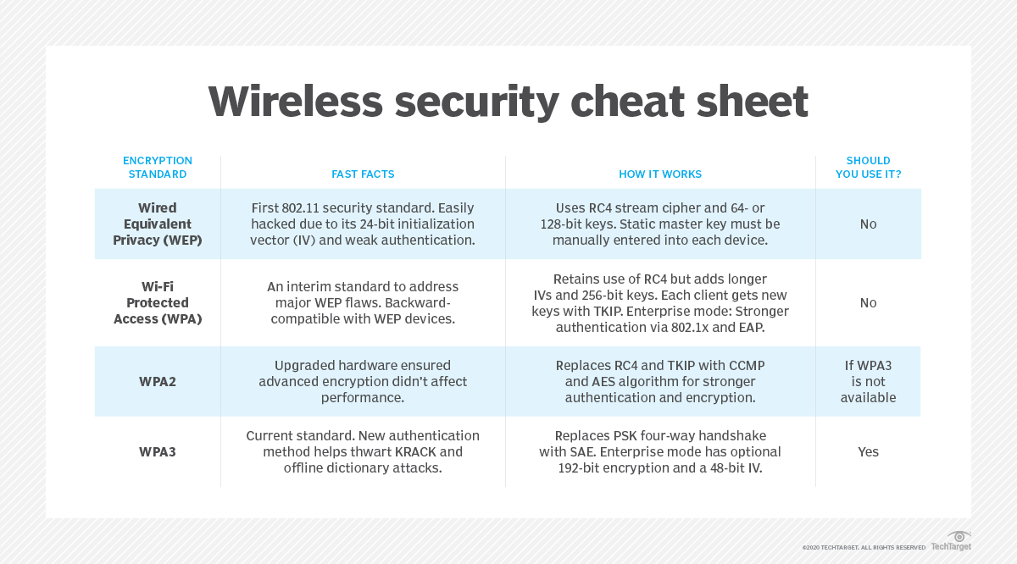

Slide 35
Links:
https://www.w3schools.com/sql/sql_injection.asp
https://www.fortinet.com/resources/cyberglossary/sql-injection
https://portswigger.net/web-security/sql-injection
https://www.f5.com/pdf/white-papers/sql-injection-detection-wp.pdf
https://www.esecurityplanet.com/threats/how-to-prevent-sql-injection-attacks/
https://www.fortinet.com/resources/cyberglossary/wireless-network
https://www.xcitium.com/blog/web-security/what-is-wireless-protected-setup/?af=713#:~:text=Wireless%20Protected%20Setup%20(WPS)%20is,enter%20the%20Wi%2DFi%20password.

